Slide 1
Socket Programming

Slide 2
Basic Theory of Socket Programming
Socket programming is a method of enabling communication between two devices (computers, servers, etc.) over a network. It is widely used to build network-based applications, such as chat applications, file sharing systems, or web servers.
What is a Socket?
A socket is one endpoint of a two-way communication link between two programs running on a network. A socket is bound to a port number and an IP address so that it can communicate with other sockets.

Slide 3
Key Terms
1. Client-Server Model:
Most socket programming follows the client-server architecture.
Server: Waits for incoming client requests.
Client: Initiates the communication with the server.
2. IP Address:
Uniquely identifies a device on the network.
Example: 192.168.1.1
3. Port Number:
Identifies a specific process or application on a device.
Common ports: 80 (HTTP), 443 (HTTPS), 21 (FTP).
4. Protocol:
Defines rules for communication.
TCP: Reliable, connection-oriented protocol.
UDP: Faster, connectionless protocol.

Slide 4
Types of Sockets
Stream Sockets (TCP):
Reliable and ensures ordered delivery of data.
Used for applications like HTTP, FTP, and SMTP.
Datagram Sockets (UDP):
Unreliable but faster.
Used for real-time applications like VoIP, online gaming.

Slide 5
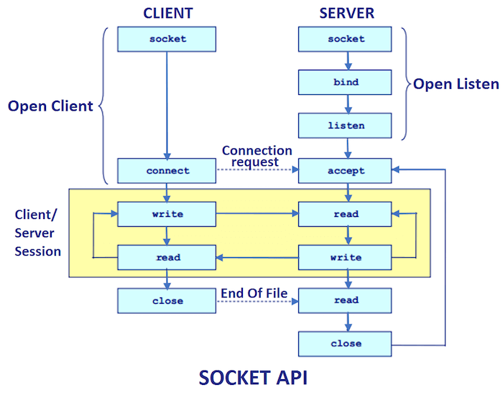
Functions
socket(): Creates a new socket.
bind(): Binds the socket to a specific address and port.
listen(): Prepares the server to accept incoming connections (TCP).
accept(): Accepts an incoming connection from a client.
connect(): Connects a client socket to a server.
send() / recv(): Sends and receives data over a connection.
close(): Closes the socket.

Slide 6
Steps in Socket Programming
Server Side:
Create a socket.
Bind it to an IP address and port.
Listen for incoming connections.
Accept a connection from a client.
Send and receive data.
Client Side:
Create a socket.
Connect to the server using its IP address and port.
Send and receive data.

Slide 7
Example Workflow
Server starts and listens on a specific port.
Client connects to the server on the same port.
Data is exchanged between the client and server.
The connection is closed when communication ends.

Slide 8
Common Functions in Java
Socket:
Represents the client-side socket.
ServerSocket:
Represents the server-side socket.
Input/Output Streams:
Used to send and receive data between sockets.
Key Methods:
accept(): Waits for a client connection (server-side).
connect(): Initiates a connection to the server (client-side).
close(): Closes the socket.

Slide 9
Steps of Socket Programming in Java
The server initiates a ServerSocket object, denoting which port number communication is to occur on.
The server invokes the accept() method of the ServerSocket class. This method waits until a client connects to the server on the given port.
After the server is waiting, a client instantiates a Socket object, specifying the server name and the port number to connect to.
The constructor of the Socket class attempts to connect the client to the specified server and the port number. If communication is established, the client now has a Socket object capable of communicating with the server.
On the server side, the accept() method returns a reference to a new socket on the server that is connected to the client's socket.

Slide 10
Advantages
Platform Independence − One of the biggest advantages of Java Sockets is that they are platform-independent. This means that the same Java code can be run on multiple operating systems and devices without the need for modification. This allows for easy deployment of network-based applications across different systems and ensures that the application can be run on different devices without the need for platform-specific code.
Easy to Use − Java Sockets are also relatively easy to use, even for developers who are new to network programming. The Java API provides a simple, consistent interface for creating and managing sockets, which makes it easy to implement network-based applications without needing to understand the underlying network protocols.
Scalability − Java Sockets are highly scalable, making them suitable for large-scale network-based applications. They can easily handle thousands of simultaneous connections and can be used to create distributed systems that can handle high levels of traffic.
Security − Java Sockets provide built-in support for secure communication, including SSL and TLS encryption. This makes it easy to create secure network-based applications and ensures that sensitive data is protected while in transit.
Multithreading − Java Sockets support multithreading, which means that multiple threads can be used to handle multiple connections simultaneously. This improves the performance of network-based applications and allows them to handle a large number of requests without becoming overloaded.

Slide 11
Disadvantages
Complexity − While Java Sockets are relatively easy to use, they can still be complex to implement, particularly for developers who are new to network programming. This complexity can make it difficult to debug and troubleshoot network-based applications, which can be time-consuming and frustrating.
Latency − Java Sockets can introduce latency into network-based applications, particularly when dealing with large amounts of data. This can be a problem for applications that require real-time communication, such as online gaming or video conferencing.
Resource Intensive − Java Sockets can be resource-intensive, particularly when dealing with large numbers of connections or large amounts of data. This can be a problem for systems with limited resources, such as mobile devices or embedded systems.
Limited Protocol Support − Java Sockets support a limited number of network protocols, which can be a limitation for certain types of network-based applications. This can make it difficult to create applications that need to communicate with other systems using proprietary protocols.
Potential for Security Vulnerabilities − Java Sockets, like any network-based application, are vulnerable to security threats, such as hacking and man-in-the-middle attacks. Careful attention must be paid to security when designing and implementing Java Socket-based systems to ensure that sensitive data is protected and potential vulnerabilities are identified and addressed.

Slide 12
Applications of Socket Programming
Chat Applications − Java Sockets are often used to create chat applications, such as instant messaging programs and online chat rooms. These types of applications typically use a client-server architecture, where clients connect to a central server to send and receive messages.
File Transfer Applications − Java Sockets can also be used to create file transfer applications, such as peer-to-peer file sharing programs. These types of applications use a peer-to-peer architecture, where each device acts as both a client and a server. This allows for direct communication between devices, which can improve the speed and reliability of file transfers.
Remote Control Applications − Java Sockets can also be used to create remote control applications, such as remote desktop software. These types of applications use a client-server architecture, where a client connects to a remote server to control the desktop of the server. This allows users to access and control their desktop from any device with an internet connection.
Multiplayer Games − Java Sockets are also commonly used to create multiplayer games, such as online role-playing games and first-person shooters. These types of applications typically use a client-server architecture, where clients connect to a central server to play the game. The server acts as the intermediary between clients, handling communication and game logic.
IoT Applications − Java Sockets can also be used in IoT (Internet of Things) applications, such as smart home systems. These types of applications use a client-server architecture, where IoT devices connect to a central server to send and receive data. This allows for remote monitoring and control of the devices, as well as data collection and analysis.

Slide 13
Key Points to Remember
Blocking vs Non-blocking:
Standard sockets are blocking, meaning the program waits for an operation to complete.
Non-blocking sockets use asynchronous calls.
Concurrency:
Use threads or thread pools on the server-side to handle multiple clients.
Error Handling:
Always handle exceptions like connection timeouts or socket closures gracefully.
Security:
Use secure sockets (e.g., SSL/TLS) for encrypted communication.

